Slide 1

Learning Graph Neural Networks with Deep Graph Library DGL
By- Gaurav Kumar Rai

Slide 2
Agenda
Overview of graph neural networks GNN
Real world uses and Tasks in GNN
Basic understanding
Overview of deep graph library (DGL)
Implementation of Semi Supervised GNN for classification.

Slide 3
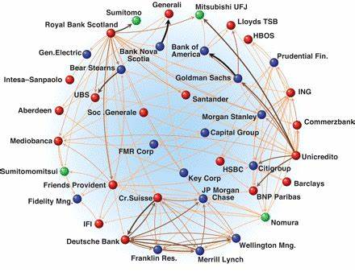
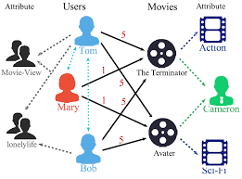
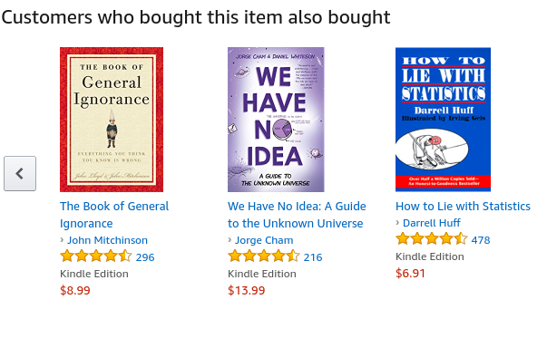
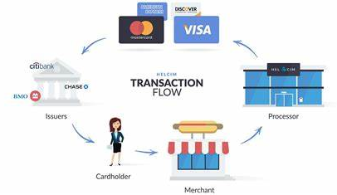
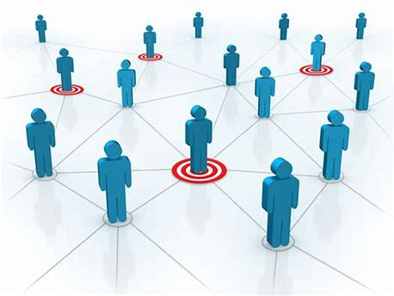

Fraud & Abuse
Recommendations
Detect malicious accounts, fraudulent financial transactions, fake reviews, fraudulent insurance claims, …
Products, media, articles, experiences, jobs, courses, spouses, …
Financial transactions network
Collaborative knowledge graph
Marketing
Who should get a discount? Who are the influencers? Who are the risk of churning?
Social network
Notes:
Graphs are present in many of these applications.

Slide 4
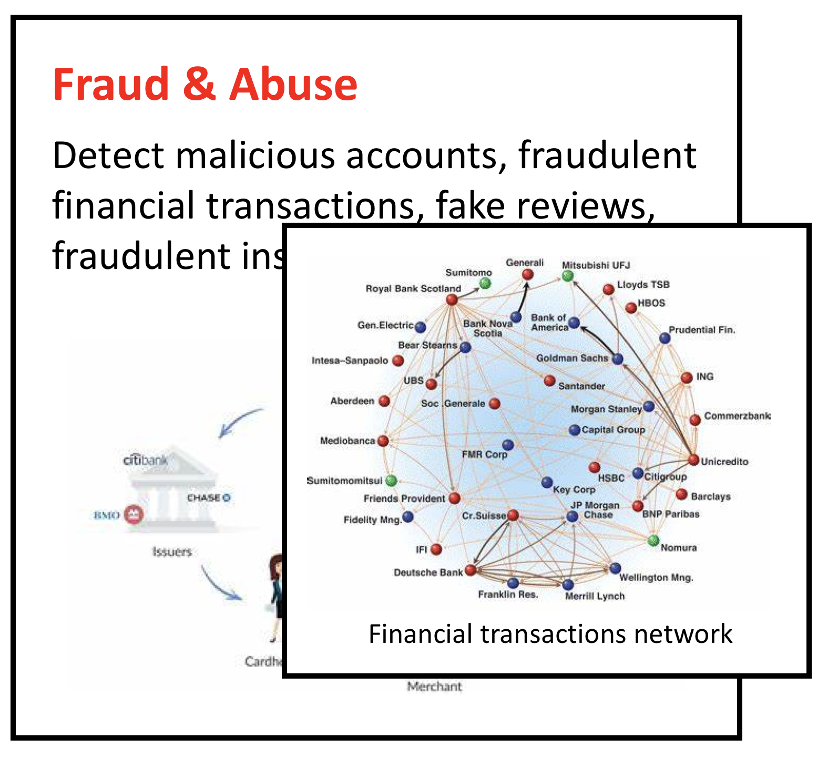
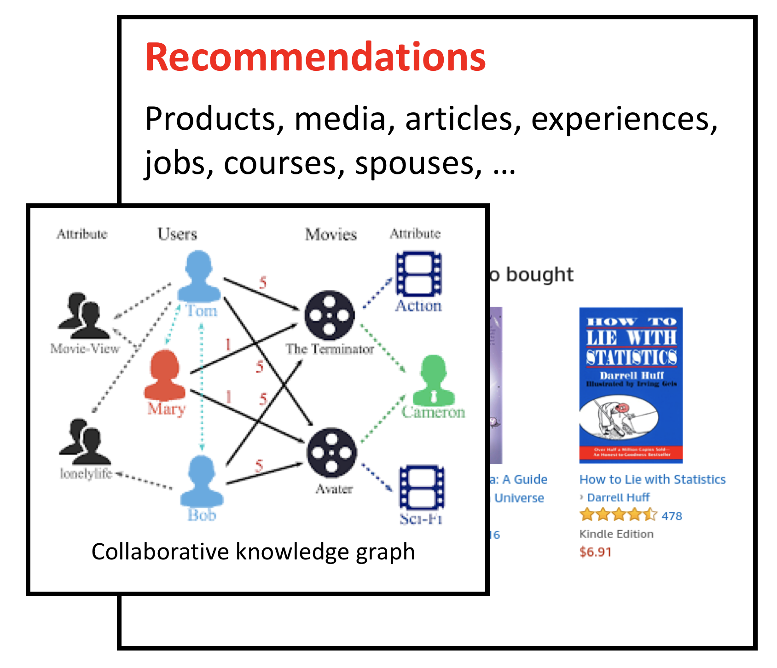
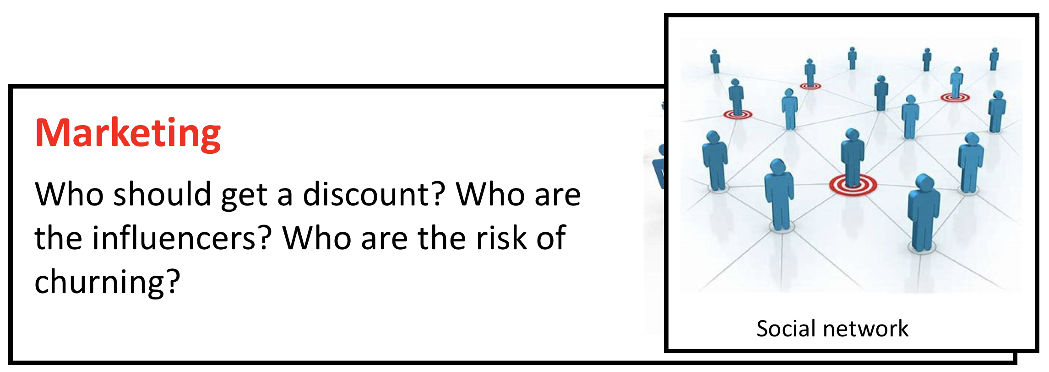
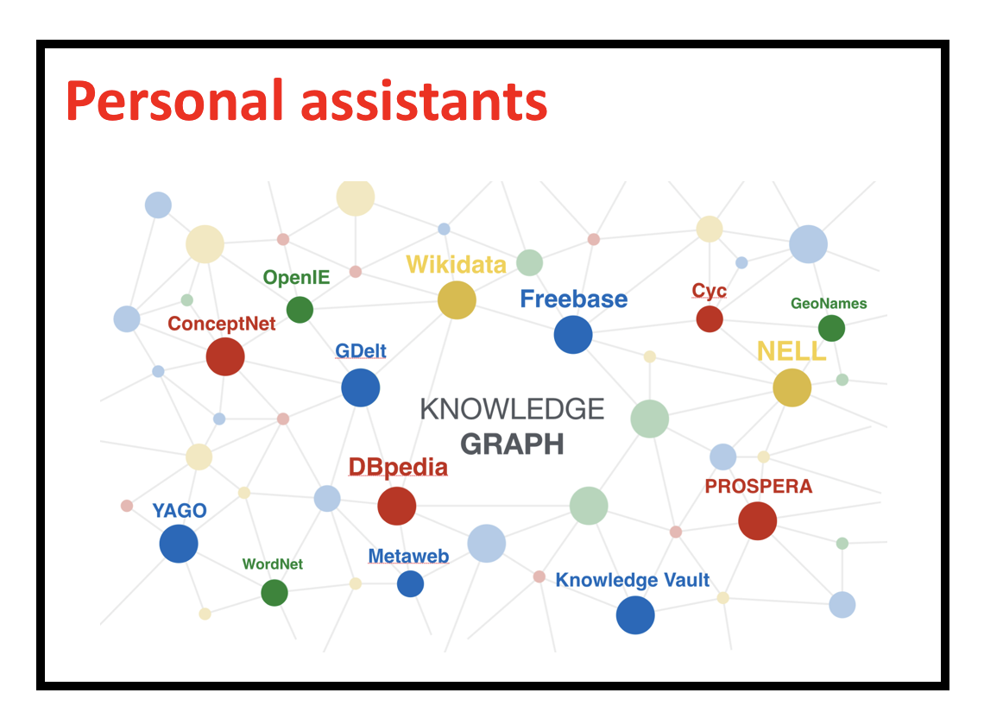
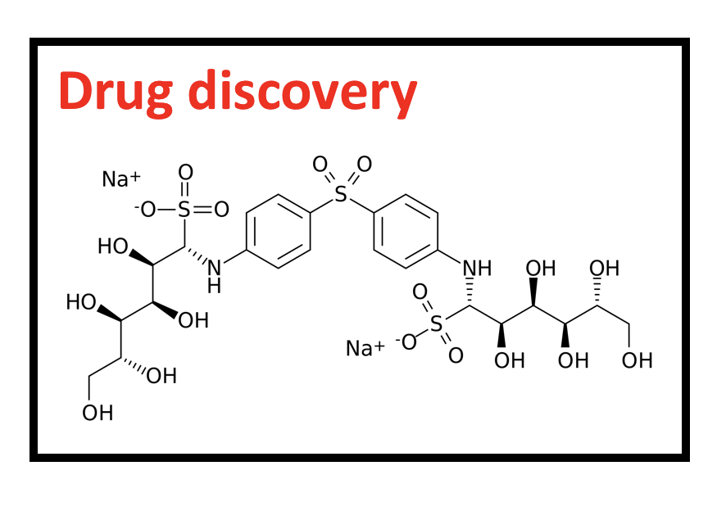
Tasks in graph learning
Node classification
Detect malicious accounts
Target right customers
Link prediction
Recommendations
Predict missing relations in a knowledge graph
Graph classification
Predict the property of a chemical compound

Slide 5
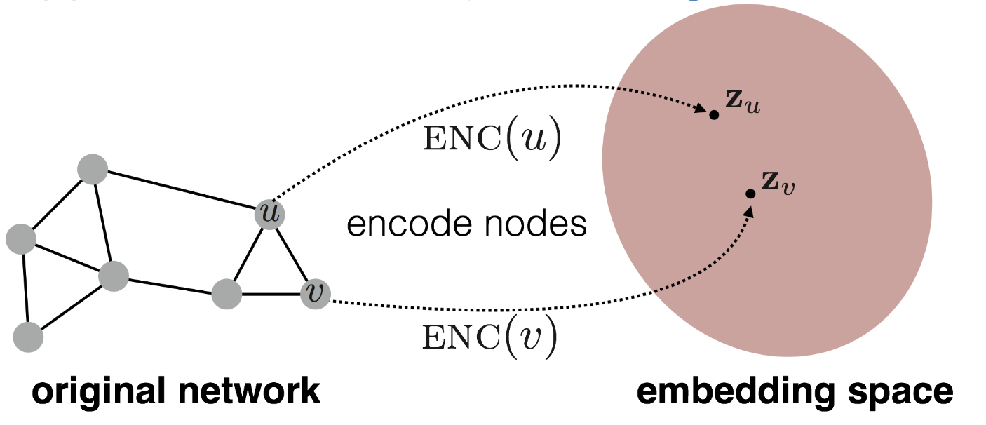
Graph learning and node embeddings
Embed nodes to a low-dimension space so that these embeddings capture the essential task-specific information and use them to train off-the-self classifiers.
For example, node similarities in the embedding space approximates the similarities in the original graph.

Slide 6
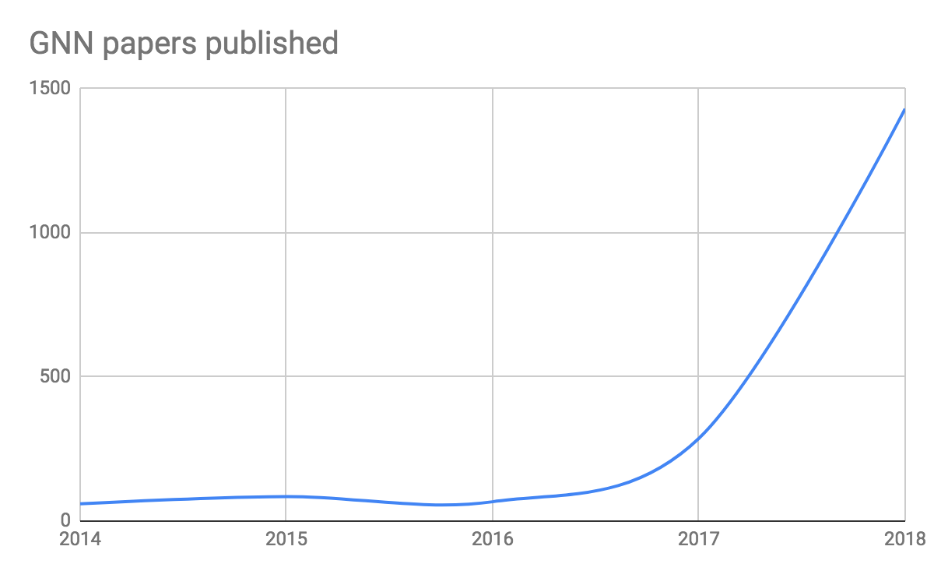
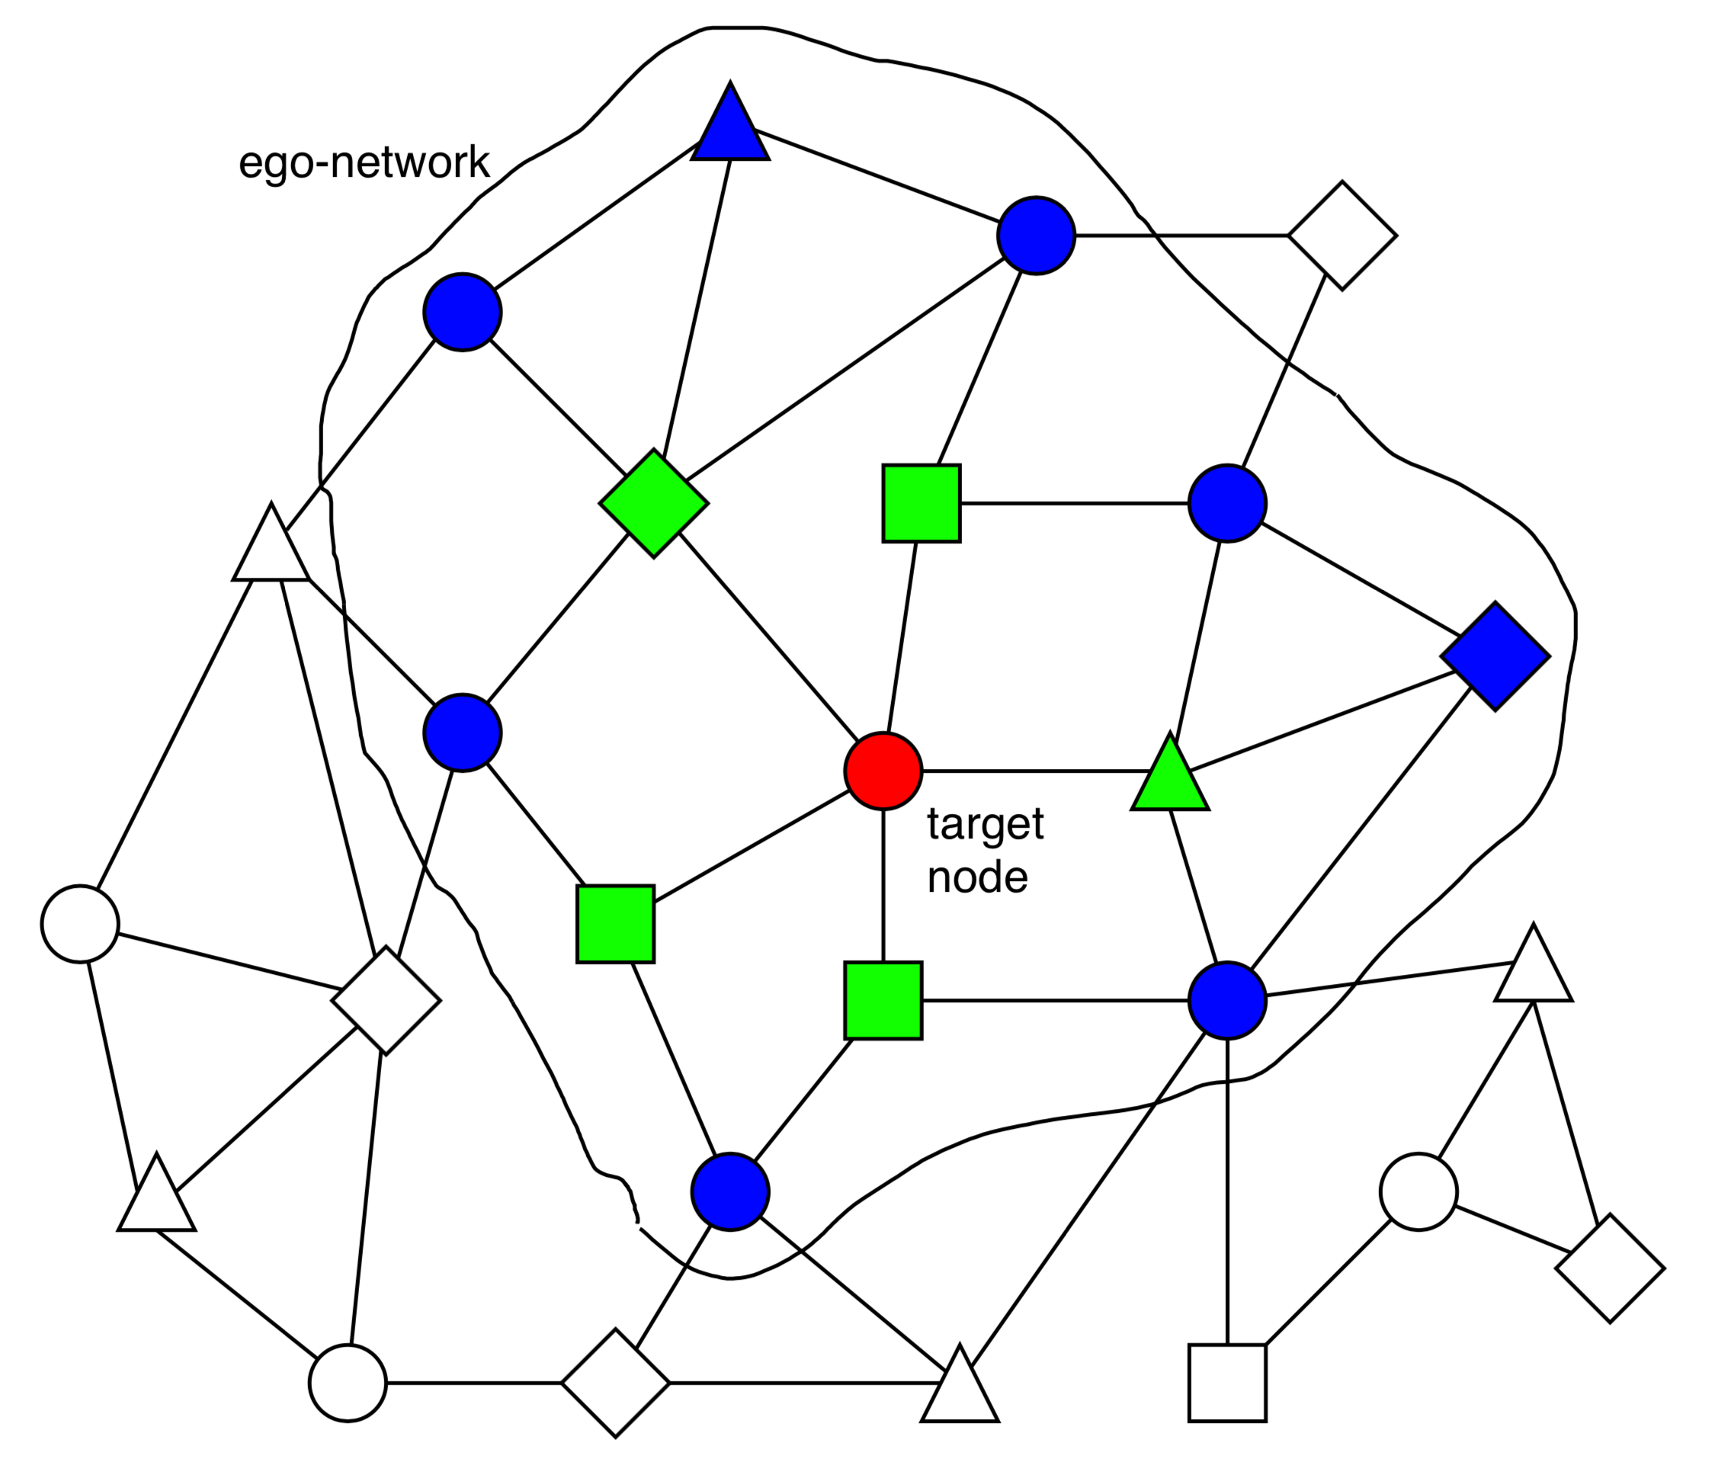
GNN gaining Popularity
They are becoming extremely popular.
Graph Neural Network (GNN)
A family of (deep) neural networks that learn node, edge, and graph embeddings.
How do GNNs work?
An ego-network around each node is used to learn an embedding that captures task-specific information.
The embeddings use both the structure of the graph and the features of the nodes and edges.
The embeddings are learned in an end-to-end fashion; thus, the predictions are a function of the target node’s ego-network.

Slide 7
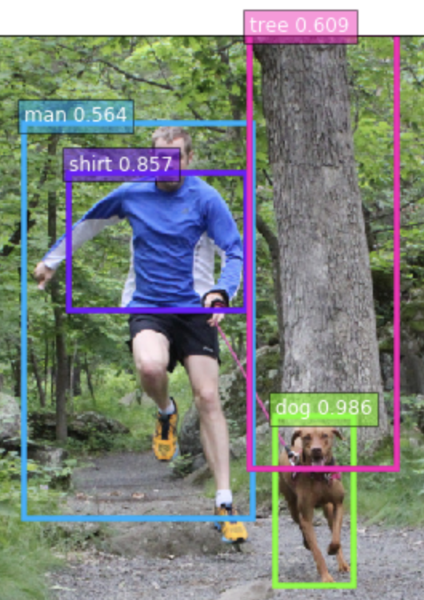
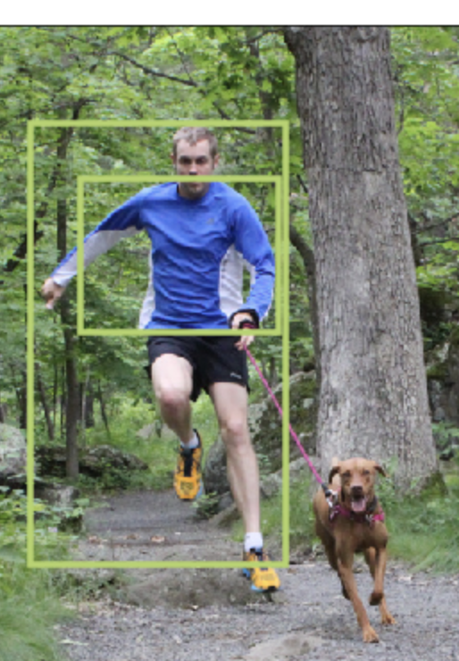
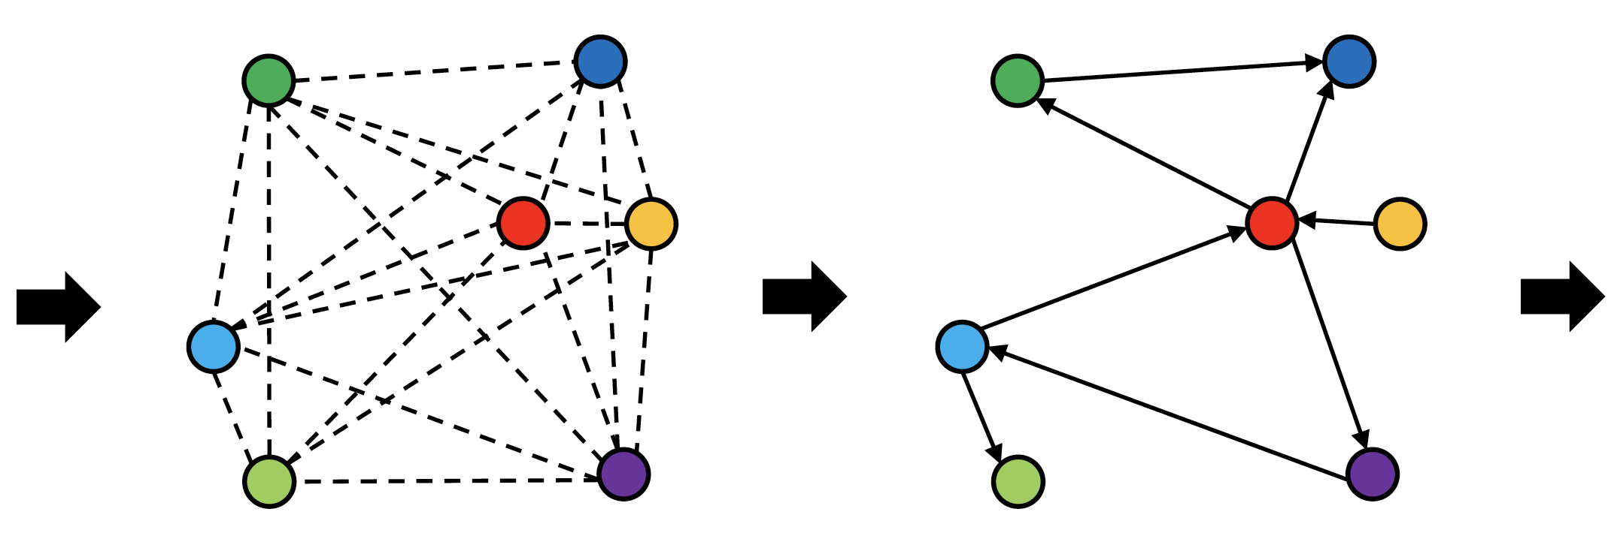
Scene graph extraction
Scene Graph Generation
Link exists with prob 68.99%
Link type:
<man> <have> <shirt>, 43.29%
<man> <wear> <shirt>, 39.64%
GCN
Object Detection
Notes:
Our model can be trained in less than one hour as it converges to produce good results. This example also shows the possible ambiguity of relationships, and how the model deals with it.

Slide 8
Why are graph neural networks better?
GNNs and the downstream classification/regression models can be trained in an end-to-end fashion.
Traditional method
Classifier
GNN
Classifier

Slide 9
Why are graph neural networks better?
GNNs are naturally inductive because they learn the same neural networks on all the nodes and edges.
GNN
GNN

Slide 10
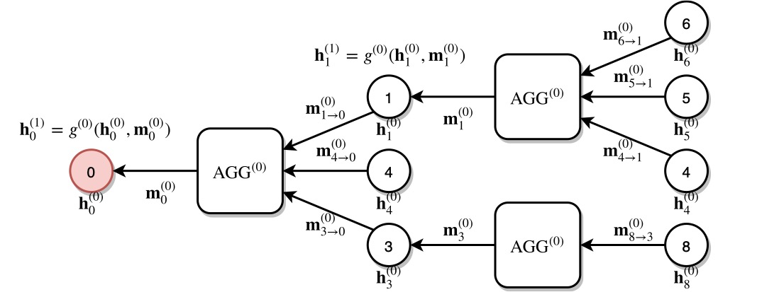
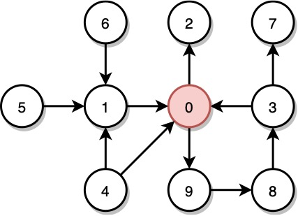
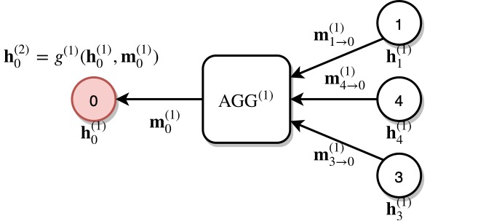
Architecture A multi-layer GNN
Multiple GNN layers can be stacked together.
1st layer
2nd layer

Slide 11
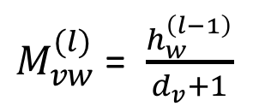
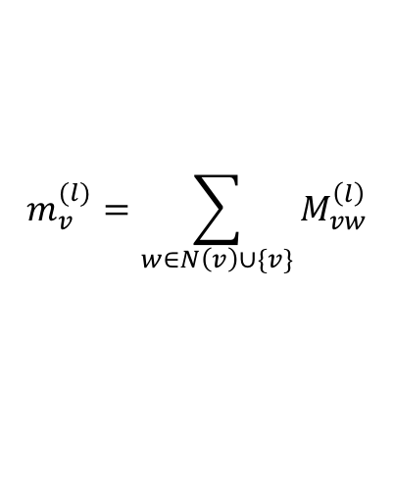
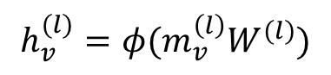
Example 1: Graph convolution network (GCN)
$M_{vw}^{(l)}$= $\frac{h_{w}^{\left(l−1\right)}}{d_{v}+1}$
$$m_{v}^{(l)}=\sum_{w∈N\left(v\right)∪\{v\}}{M_{vw}^{\left(l\right)}}$$
$$h_{v}^{(l)}=φ(m_{v}^{\left(l\right)}W^{(l)})$$

Slide 12
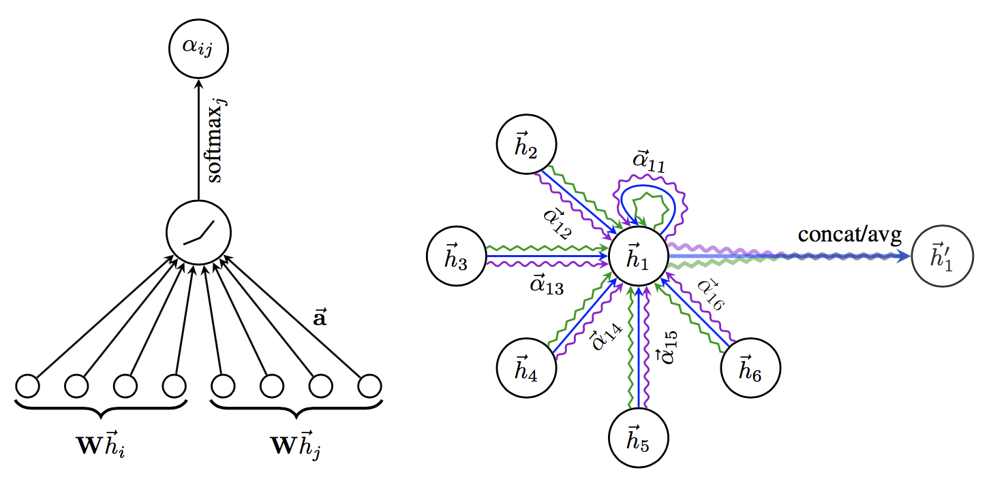
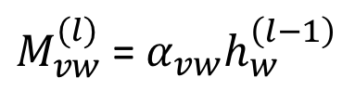
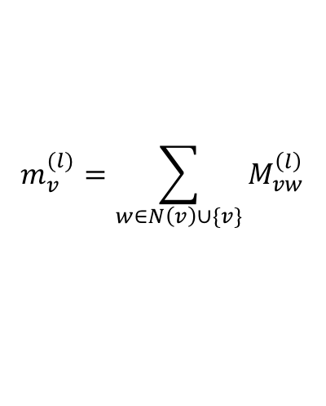
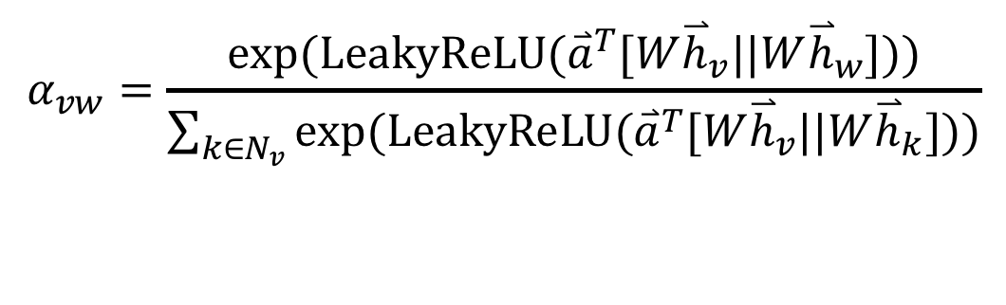
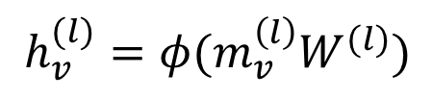
Example 2: Graph attention networks (GAT)
GAT provides weighted sum over the neighborhood—Enables to selectively integrate information.
$M_{vw}^{(l)}$= $α_{vw}h_{w}^{\left(l−1\right)}$
$$m_{v}^{(l)}=\sum_{w∈N\left(v\right)∪\{v\}}{M_{vw}^{\left(l\right)}}$$
$$h_{v}^{(l)}=φ(m_{v}^{\left(l\right)}W^{(l)})$$
$$α_{vw}=\frac{exp⁡(LeakyReLU({\overset{⃑}{a}}^{T}[W{\overset{⃑}{h}}_{v}||W{\overset{⃑}{h}}_{w}]))}{\sum_{k∈N_{v}}{exp⁡(LeakyReLU({\overset{⃑}{a}}^{T}[W{\overset{⃑}{h}}_{v}||W{\overset{⃑}{h}}_{k}]))}}$$

Slide 13
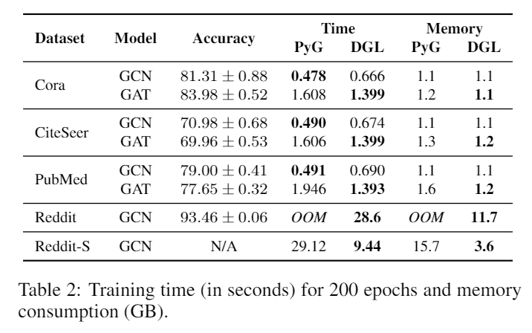
Evaluation: efficiency and memory consumption
Testbed: one V100 GPU (16GB)

Slide 14
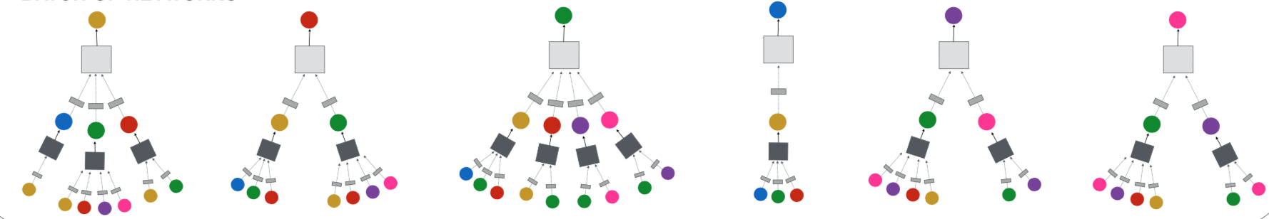
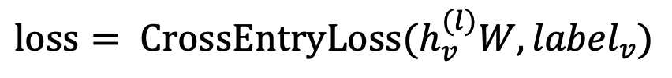
WE are using: Node classification with GNN
Node classification is trained in the semi-supervised setting.
$$loss= {CrossEntryLoss(h}_{v}^{(l)}W, {label}_{v})$$
0
1
0
?
?
?

Slide 15
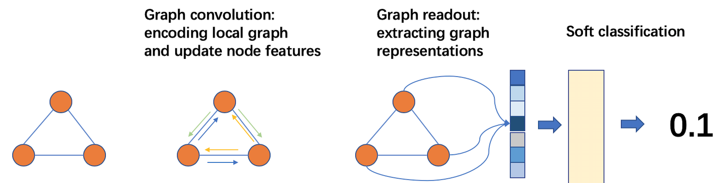
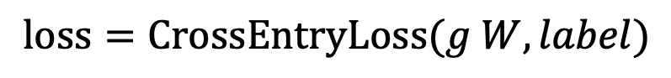
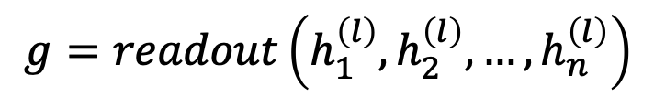
Graph classification using DGL
Graph readout to compute graph embeddings.
Train a graph classifier on the graph embedding.
$$g=readout\left(h_{1}^{\left(l\right)},h_{2}^{\left(l\right)}, …,h_{n}^{\left(l\right)}\right)$$
$$loss=CrossEntryLoss(g W, label)$$

Slide 16
Training GNN on large graphs
Many applications have extremely large graphs—millions of nodes and billions of edges:
Social networks
Recommendation
Knowledge graph
A typical training method: mini-batch training

Slide 17
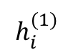
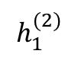
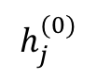
A glance of mini-batch training on graphs
A mini batch represents the computation graph for target nodes.
Small-world graphs lead to a huge computation graph.
2
3
$$h_{1}^{(2)}$$
1
1
10
5
$$h_{i}^{(1)}$$
2
3
4
5
6
9
4
6
8
7
$$h_{j}^{(0)}$$
1
3
4
6
7
8
9
10
11
11

Slide 18
Mini-batch with neighbor sampling
Prune the computation graph:
Sample neighbors from a neighbor list of a vertex.
1
1
2
3
4
5
6
2
4
1
7
8
1
3
4
6
7
8
9
10
11

Slide 19

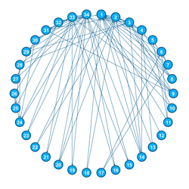
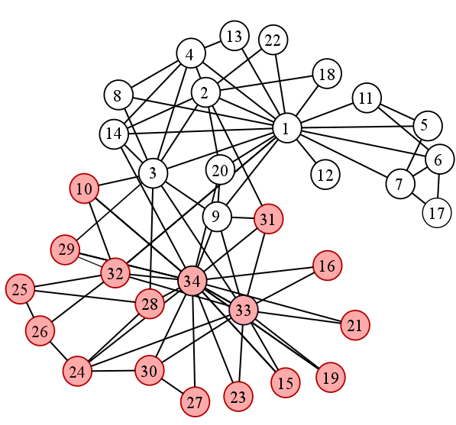
Zachery’s (Infamous) Karate Club

Slide 20
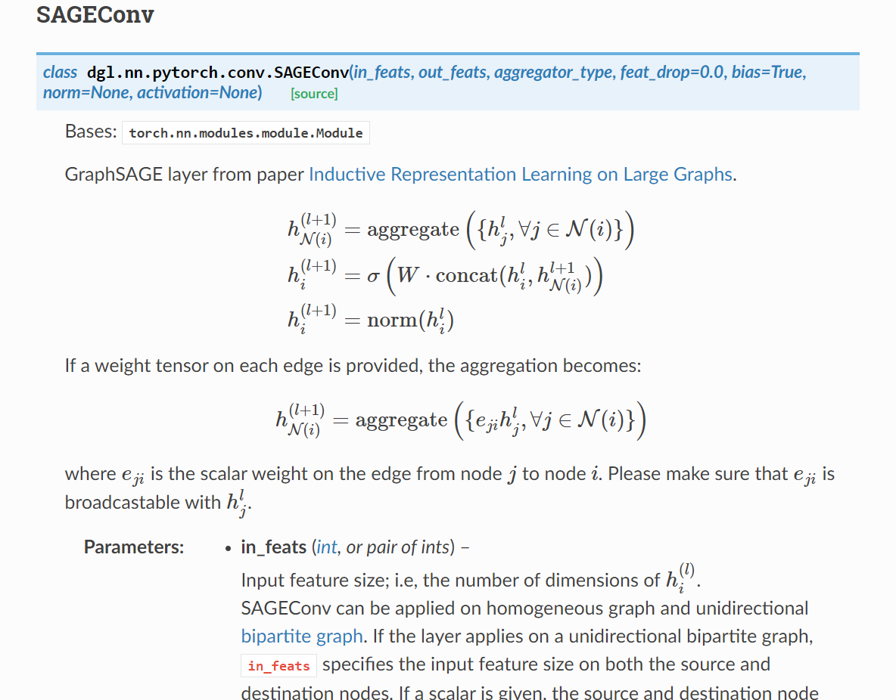
Module SAGEConv in DGL

Slide 21
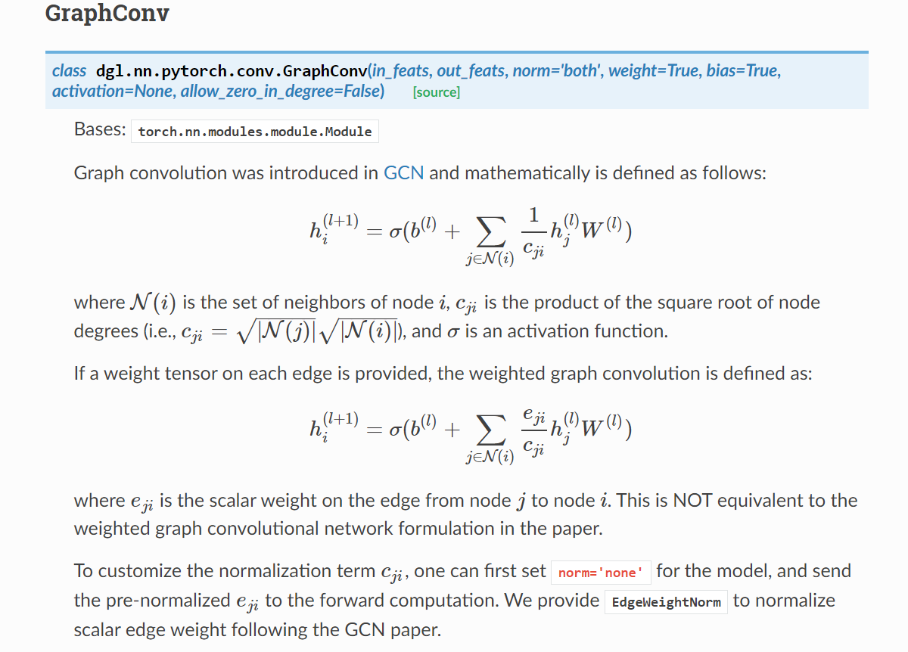
Module GraphConv in DGL

Slide 22
PLAN Ahead
Training the model on big graph datasets.
Using different training methodologies, tune the model with different hyperparameter settings and note down the time required for training and accuracy obtained.
Datasets: We can use the publicly available QM9 dataset Ramakrishnan et al. (2014).
Make a brief report.

Slide 23
REFERENCES
Thomas N. Kipf Semi supervised classification – ICLR conference
INFOGRAPH UNSUPERVISED AND SEMI-SUPERVISED Graph level ICLR

Slide 24
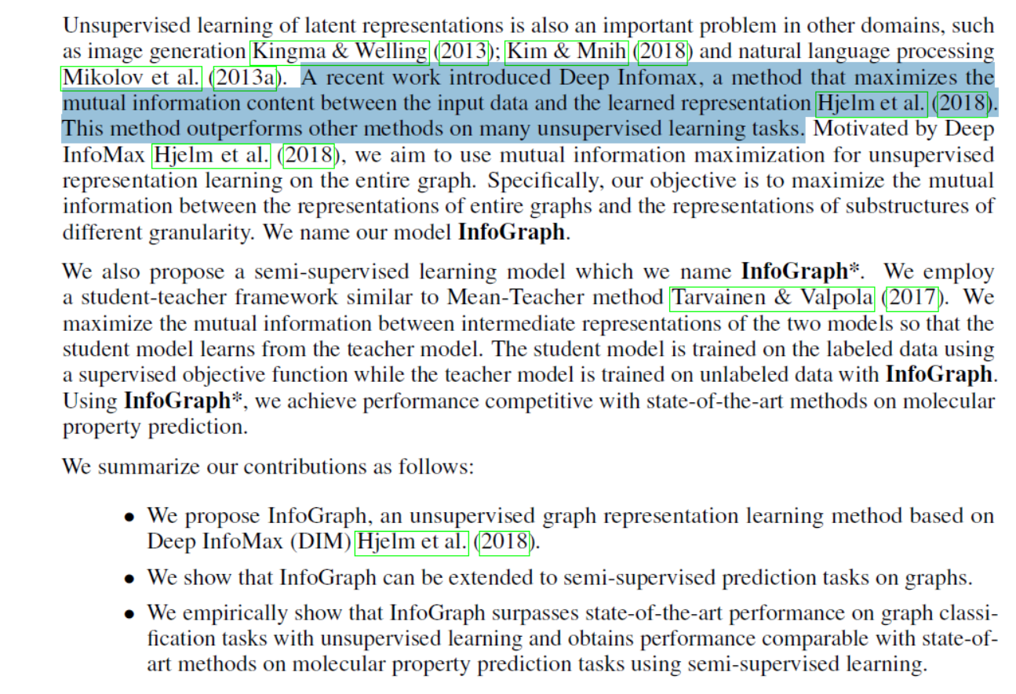

Slide 25
